Slide 1
WELCOME TO
DEPARTMENT OF ZOOLOGY
GOVERNMENT CHANDULAL CHANDRAKAR ARTS AND SCIENCE COLLEGE PATAN, DISTRICT – DURG (C.G.)

Slide 3
SANCTIONED POST-
01-Assistant Professor- D. K. BHARDWAJ
02-Posts are sanctioned by JBS Committee.
Teaching Staff
Session
Experience
Mr. D.K. Bhardwaj (HOD) | 1987-2021 | 29 Years
Mr. Parmeshwar Sahu | 2019-2020 | 4 Years
Mr. Tejram Sahu | 2019-2020 | 1 year
Mr. Tejram Sahu | 2020-2021 | 2 years
Ms Rupali Tiwari | 2020-2021 | 4.5 years

Slide 4
Courses Run by the Department
(1) B.Sc. (Biology)
ZOOLOGY IN B.SC. (SINCE 1990)
AFFILIATION WITH HEMCHAND YADAV VISHWAVIDYALAYA, DURG SINCE 2015-16
AFFILIATION WIH PT. RAVISHANKAR UNIVERSITY RAIPUR UP TO 2015
EXAMINATION PATTERN- ANNUAL EXAMINATION
INTAKE 60 STUDENTS

Slide 5
Courses Run by The Department-
(2) M.Sc. In Zoology
M.SC. IN ZOOLOGY SINCE 2010-11.
THIS IS A TWO YEAR PROGRAM CONSISTING OF 4 SEMESTERS
AFFILIATION- HEMCHAND YADAV VISHWAVIDYALAYA, DURG
INTAKE 25 STUDENTS
SANCTION- 01 POST (GOVT.), 02 POSTS- JBS TEACHERS (JBS)

Slide 6
YEAR | STUDENTS APPEARED | SUDENTS PASSED | PASS PERCENTAGE
2015-2016 | M.Sc. -IV 19 | 19 | 100%
2016-2017 | M.Sc. -IV 16 | 16 | 100%
2017-2018 | M.Sc. -IV 19 | 19 | 100%
2018-2019 | M.Sc. -IV 19 | 15 | 79%
2019-2020 | M.Sc. -IV 20 | 17 | 85%
EXAM RESULT OF M.Sc. ZOOLOGY

Slide 7
DEPARTMENTAL ACHIEVEMENTS
MERIT LIST- 15 STUDENTS
JRF-01 STUDENT
SET SELECTED -01 STUDENT
WELL EQUIPPED LAB
LEARNING THROUGH EDUCATIONAL TOUR
COOPERATION WITH HOSPITAL FOR STUDENTS’ HEALTH WELFARE THROUGH YOUTH RED CROSS
VIDYADAN YOJNA- FREE TEACHING SCHEME TO CHILDREN DURING COVID-19

Slide 8
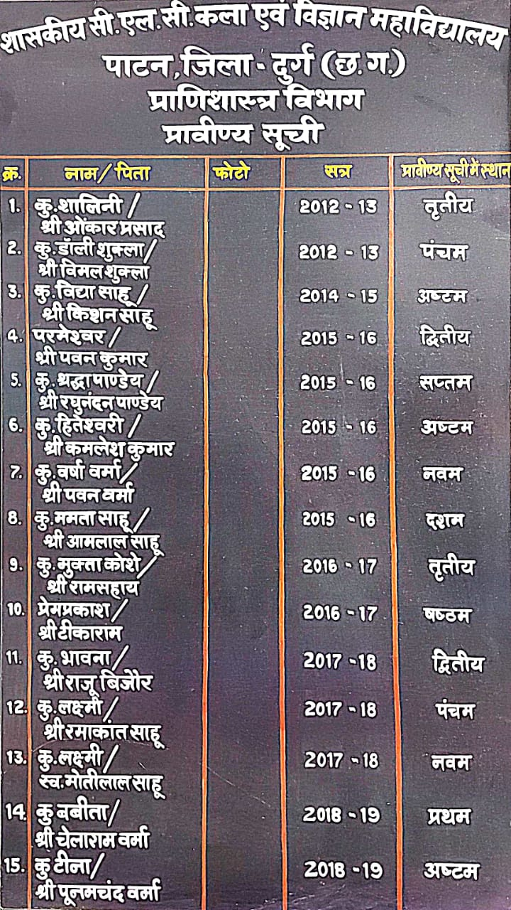
DEPARTMENTAL ACHIEVEMENT
MERIT STUDENTS
Year | No. of Merit Students
22012-13 | 2
2014-15 | 1
2015-16 | 5
2016-17 | 2
2017-18 | 3
2018-19 | 2
We are proud of our students.

Slide 9
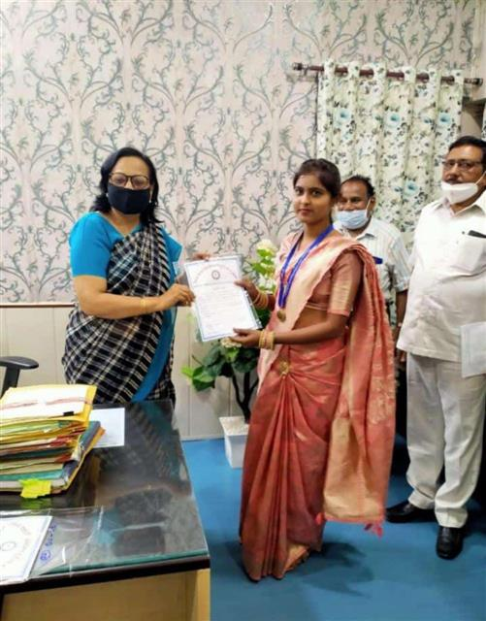
GOLD MEDALIST
Session 2018-2019
Kumari Babita D/O Chelaram Verma
1st Position in Merit
(M.Sc. Zoology)
(HEMCHAND YADAV VISHWAVIDYALAYA, DURG )
Govt. CLC Arts and Science college
Patan (Durg)

Slide 10
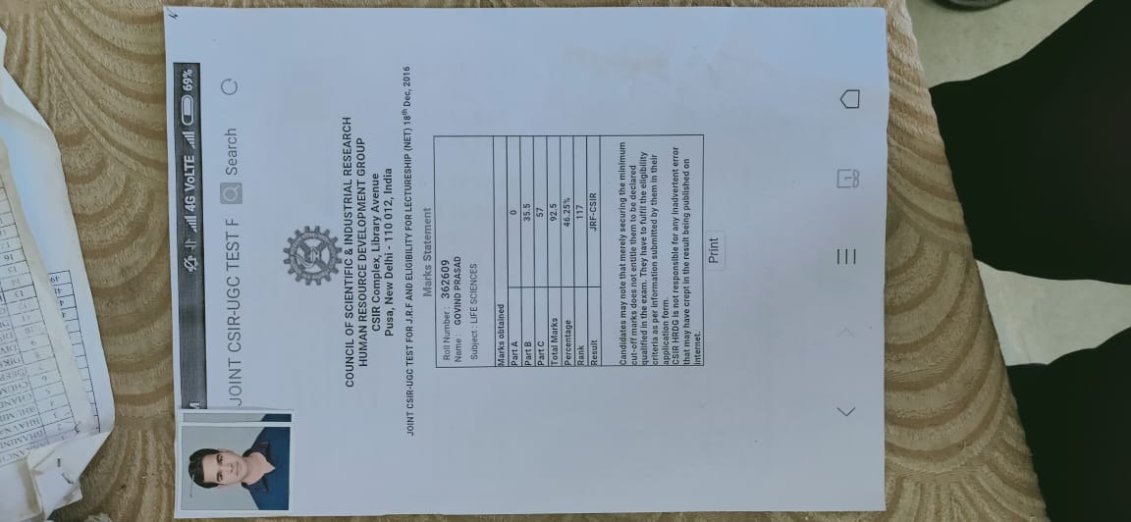
2. DEPARTMENTAL ACHIEVEMENT
GOVIND PRASAD -
“NET” (JRF) SELECTED
18TH DEC, 2016
GOVIND PRASAD S/O KUNJBIHARI SAHU
M.SC. ZOOLOGY ( IV SEMESTER) MAY 2015
GOVT. C.L.C. ARTS & SCIENCE COLLEGE PATAN (DURG)

Slide 11
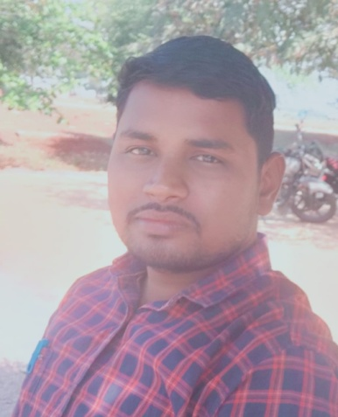
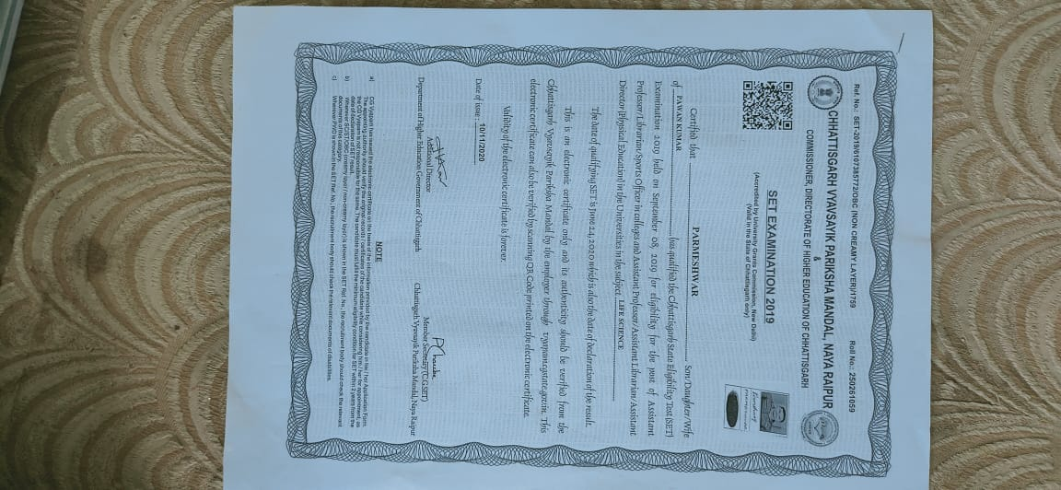
3. DEPARTMENTAL ACHIEVEMENT
PARMESHWAR - “SET” SELECTED
08TH September 2019
Parmeshwar S/O Pawan Kumar
M.Sc. Zoology (IV semester) May 2016
Govt. C.L.C Arts & Science College Patan (Durg)

Slide 12
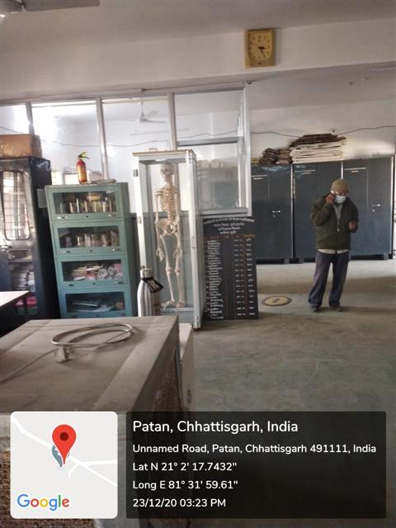
WELL EQUIPPED LAB

Slide 13
4. EDUCATIONAL TOURS
Water Filter Plant in Bhatagaon, Raipur
Chhattisgarh Science Centre, Raipur
(C) Fish Hatchery, Demar, Dist.-Dhamtari (C.G.)

Slide 14
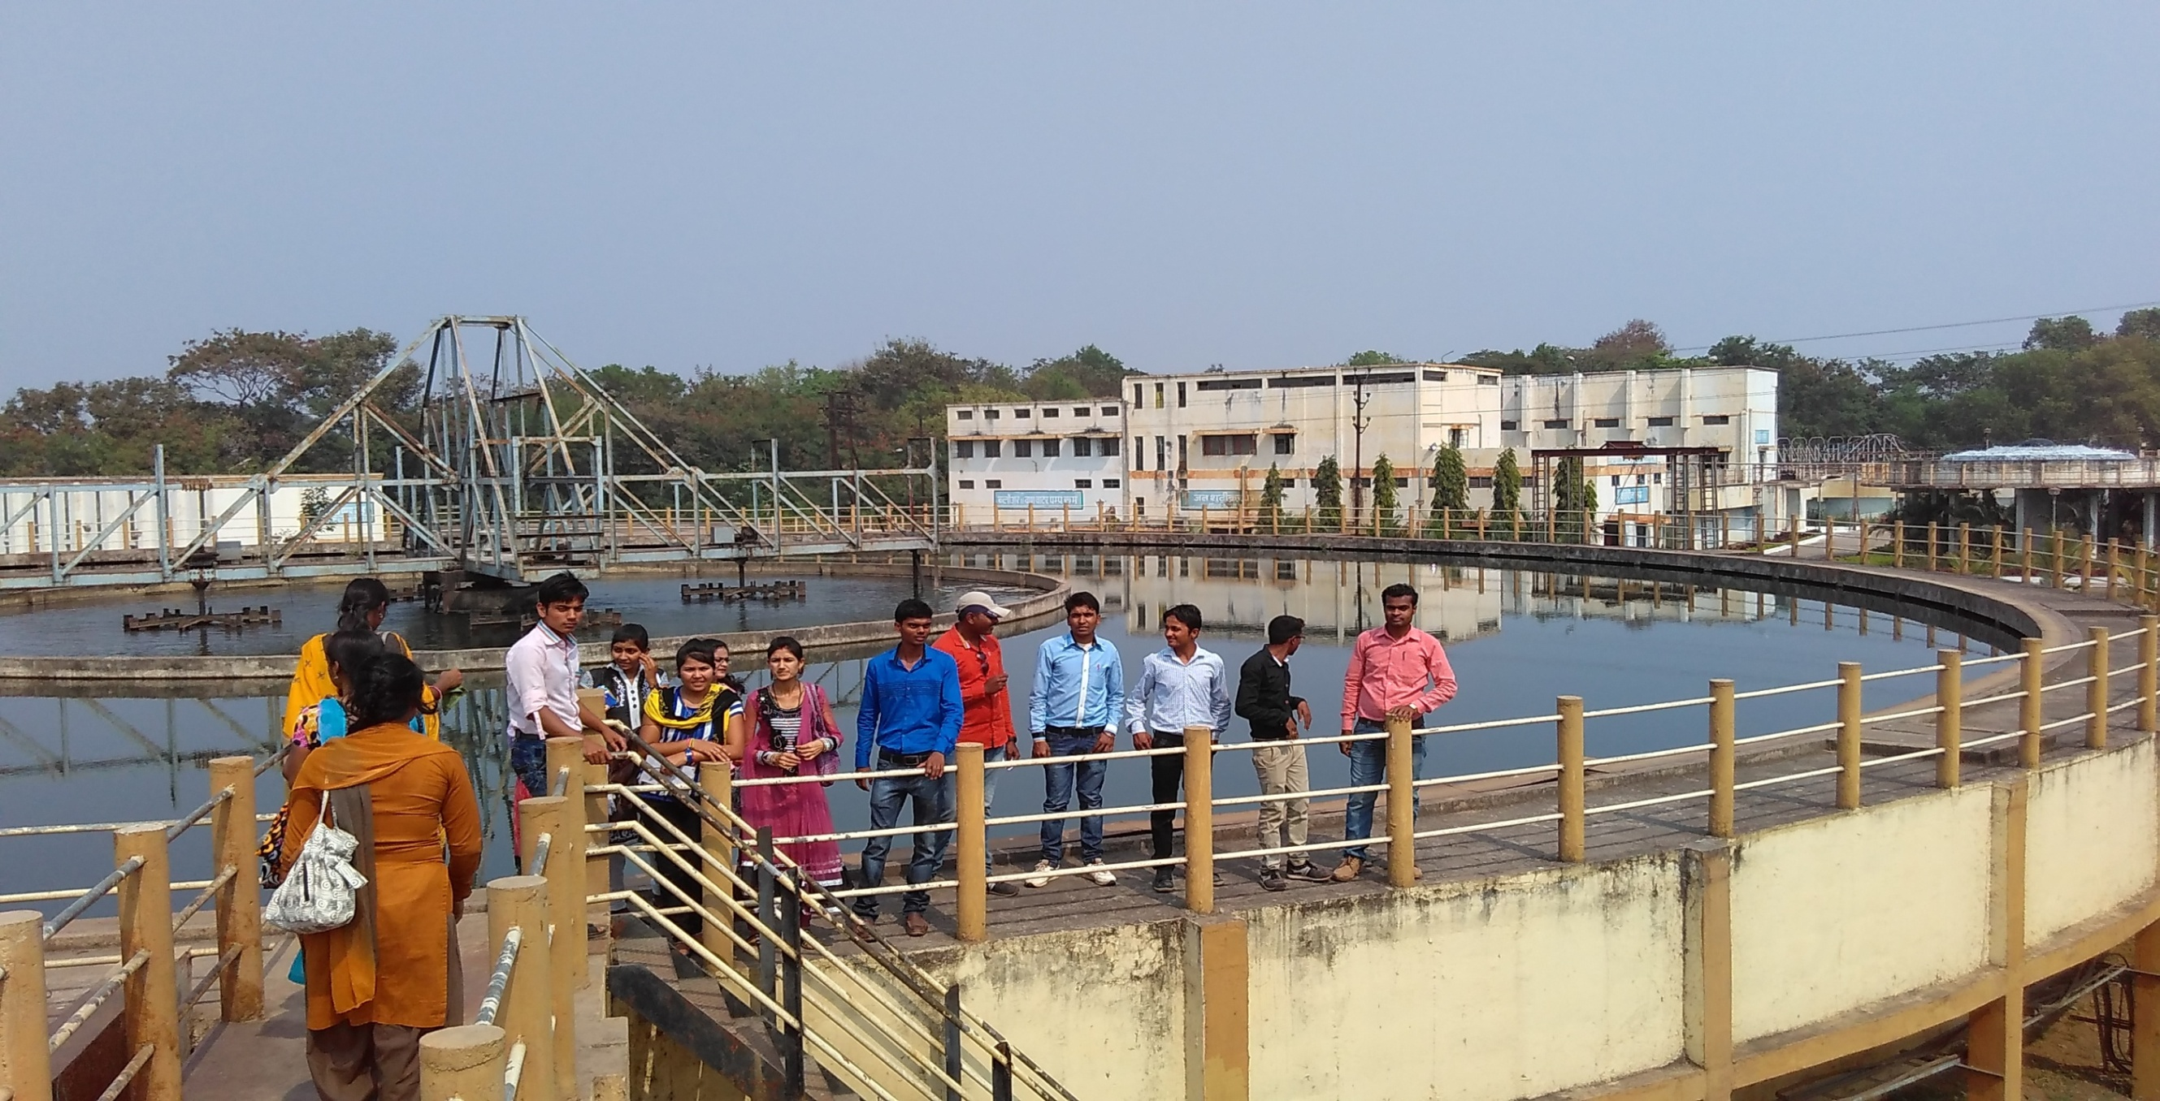
LEARNING THROUGH EDUCATIONAL TOUR- DATE:25.02.2016
WATER FILTER PLANT BHATAGAON RAIPUR, CHHATTISGARH

Slide 15
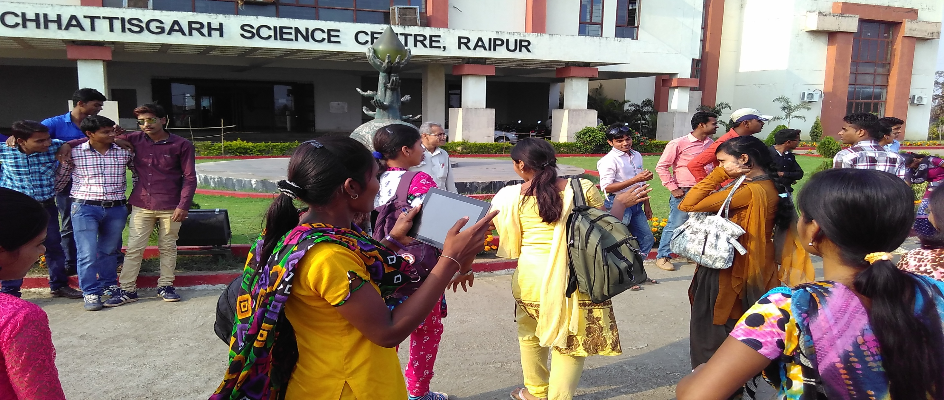
LEARNING THROUGH EDUCATIONAL TOUR- DATE: 25.02.2016 CHHATTISGARH VIGYAN KENDRA RAIPUR, C.G.

Slide 16
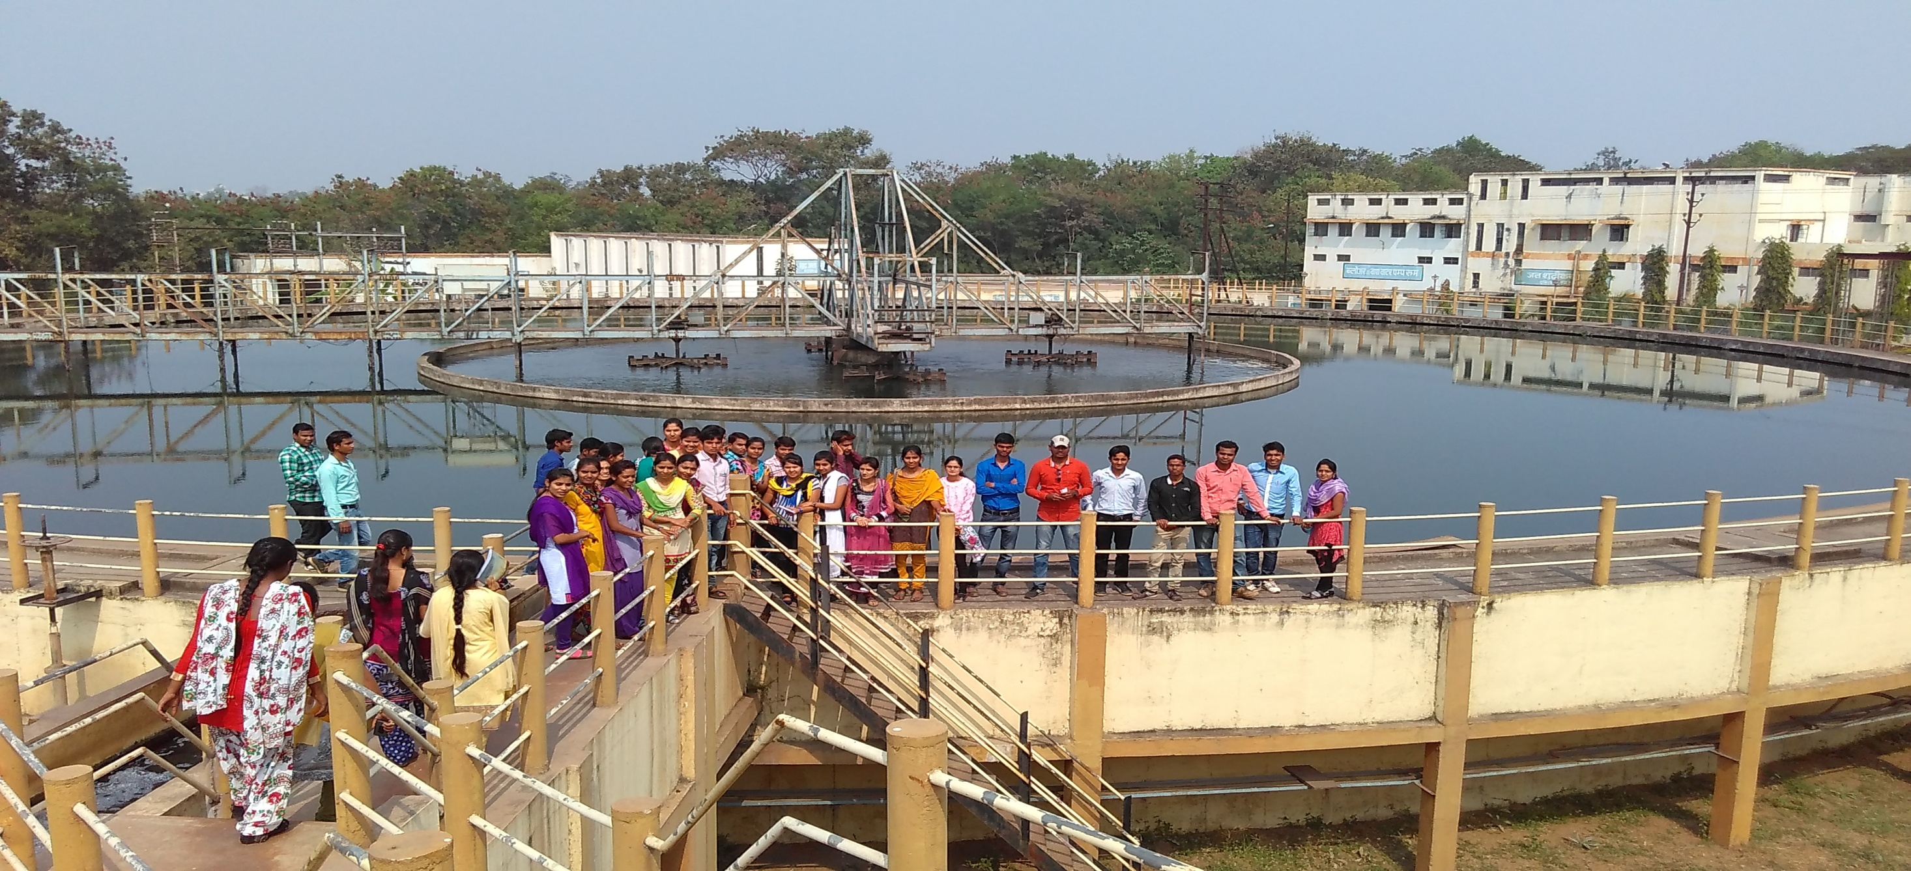
LEARNING THROUGH EDUCATIONAL TOUR- DATE: 25.02.2016
WATER FILTER PLANT BHATAGAON RAIPUR, CHHATTISGARH

Slide 17
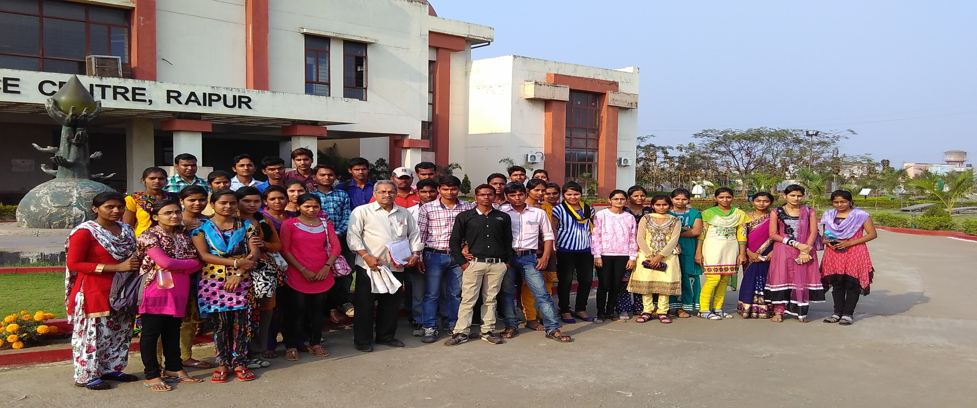
LEARNING THROUGH EDUCATIONAL TOUR- DATE: 25.02.2016
CHHATTISGARH VIGYAN KENDRA RAIPUR, C.G.

Slide 18
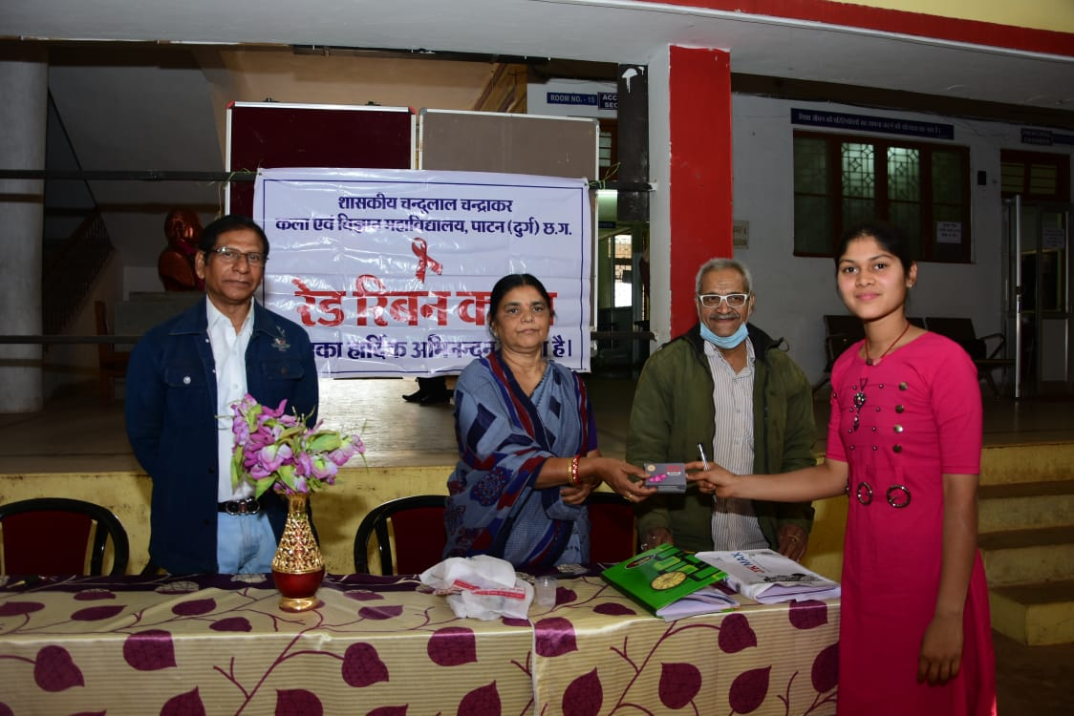
COOPERATION WITH STATE AIDS CONTROL BOARD RAIPUR TO INCREASE HEALTH AWARENESS ON AIDS AWARENESS DAY

Slide 19
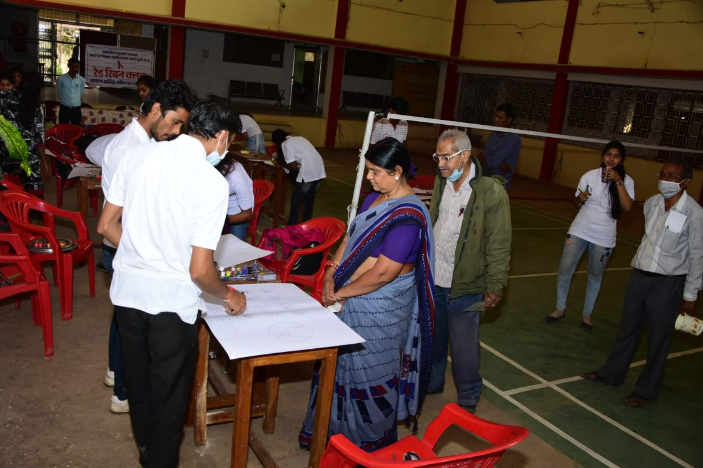
COOPERATION WITH STATE AIDS CONTROL BOARD RAIPUR TO INCREASE HEALTH AWARENESS ON AIDS AWARENESS DAY

Slide 20
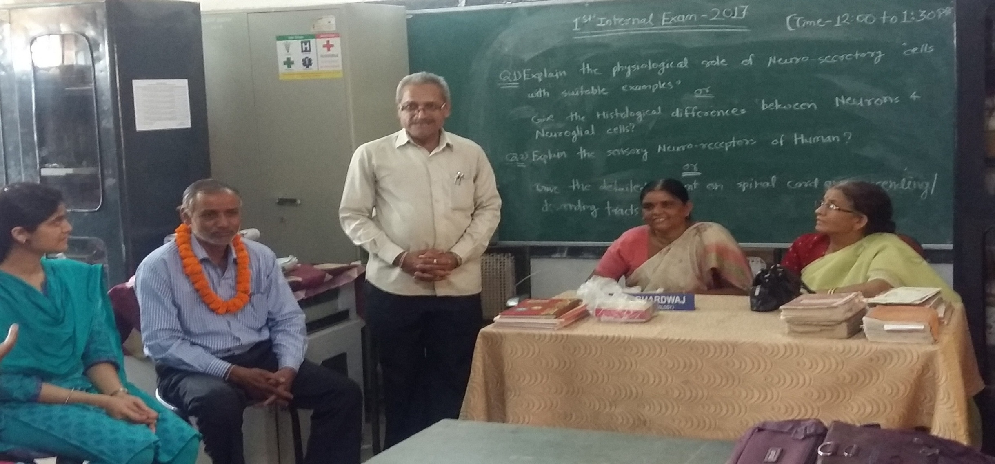
MEMORABLE EVENT
FAREWELL TO D.C. SAHU (LAB ATTENDANT, ZOOLOGY)

Slide 21
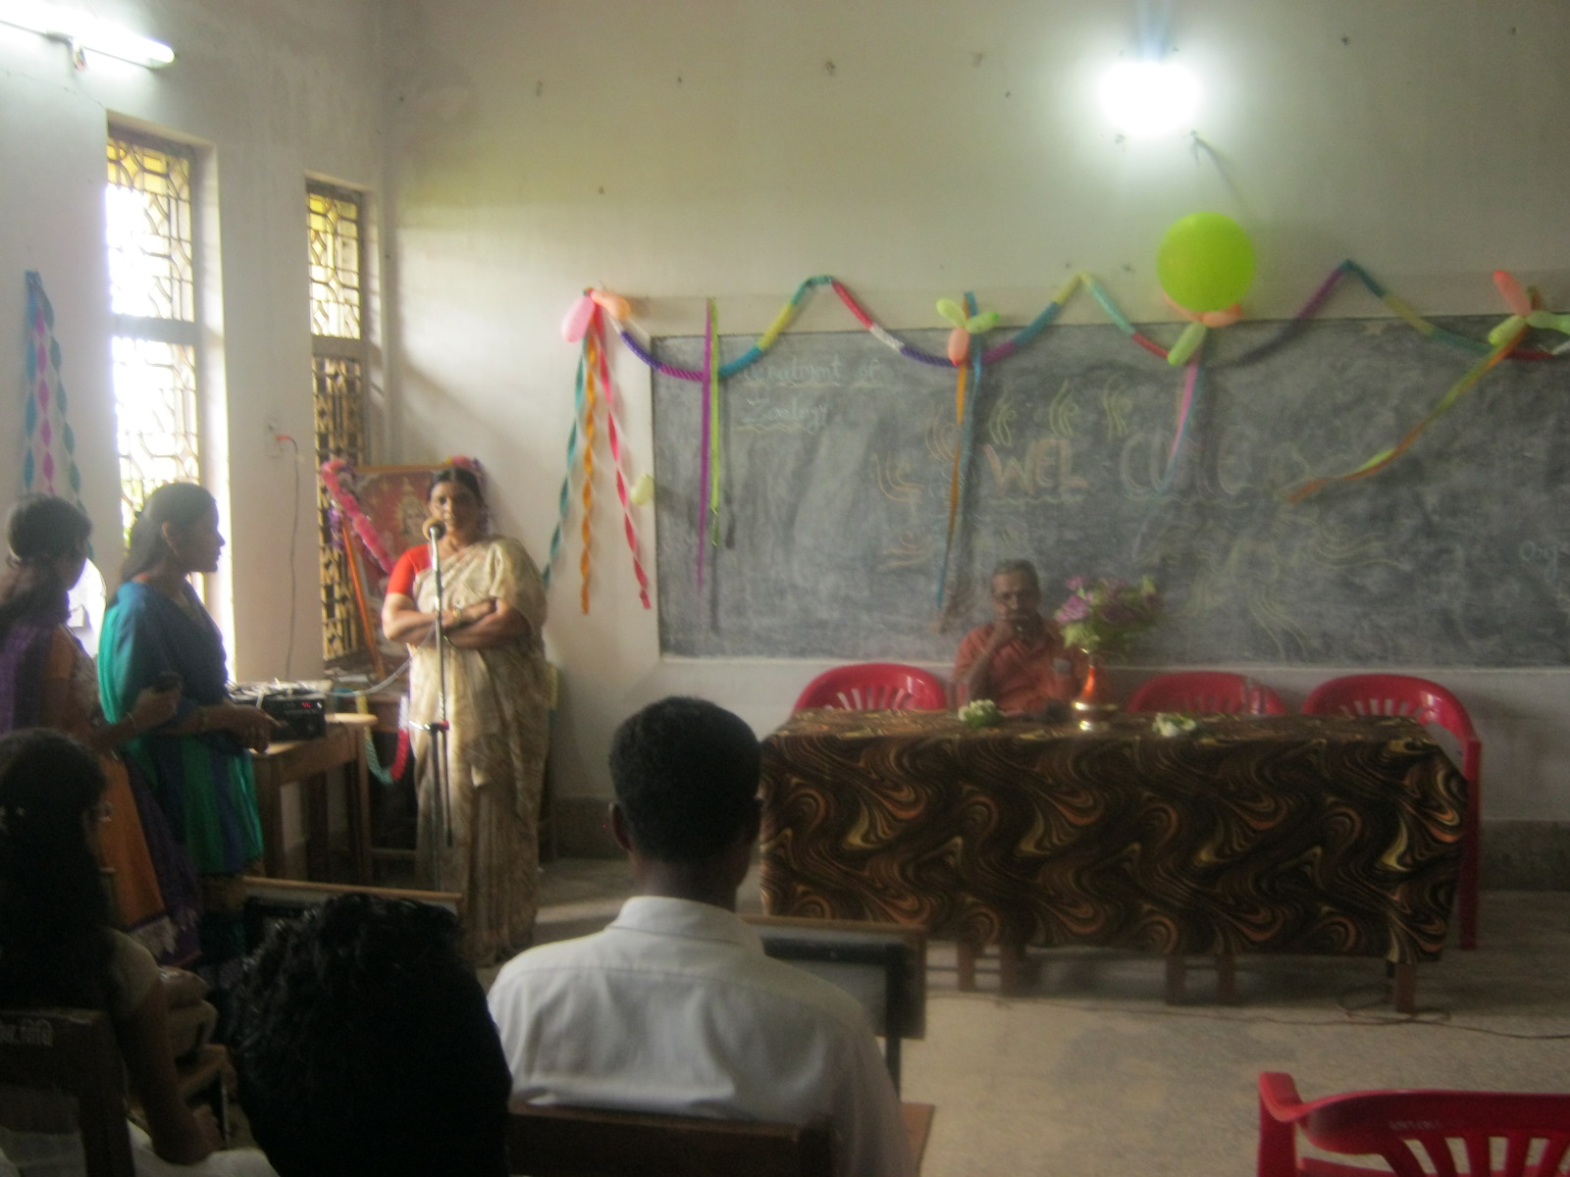
WELCOME TO NEW P.G. STUDENTS OF ZOOLOGY 2015-16

Slide 22
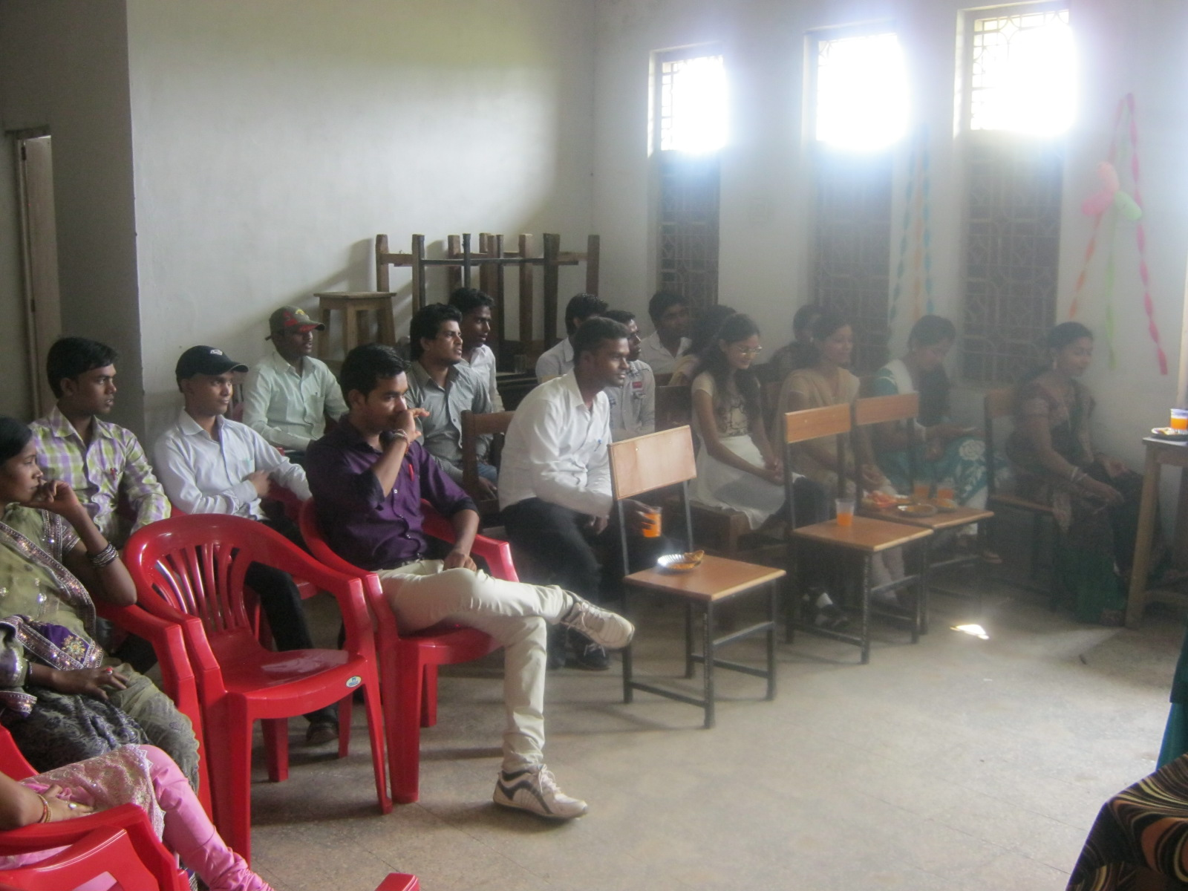
WELCOME TO NEW P.G. STUDENTS OF ZOOLOGY 2015-16

Slide 23
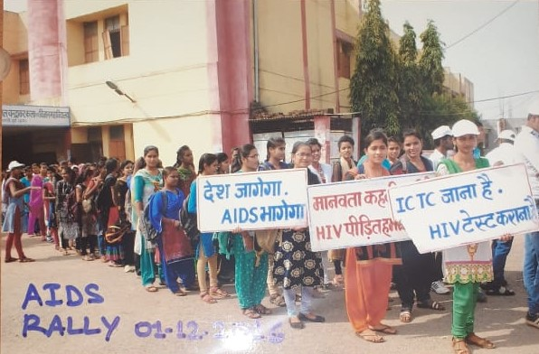
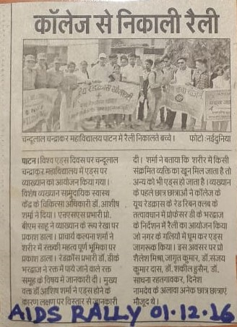
CROSS CUTTING ISSUES RELATED TO ZOOLOGY DEPARTMENT
(GLIMPSES FROM RED CROSS UNIT)

Slide 24
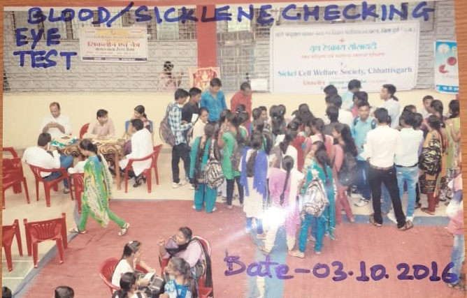

Slide 25
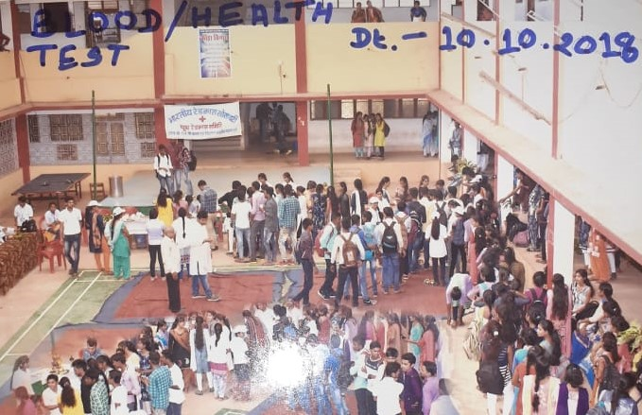
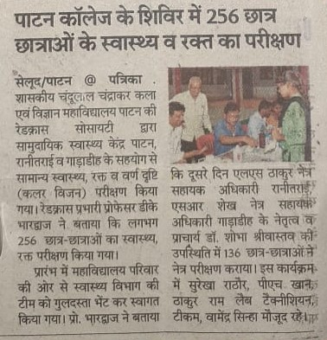

Slide 26
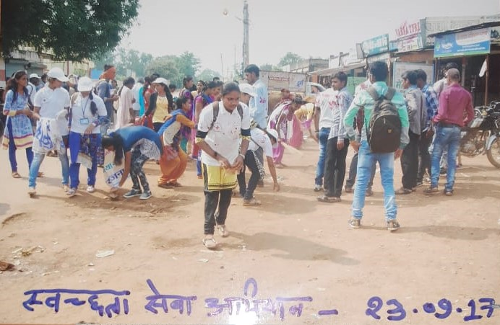
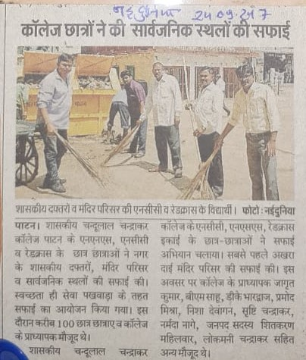

Slide 27
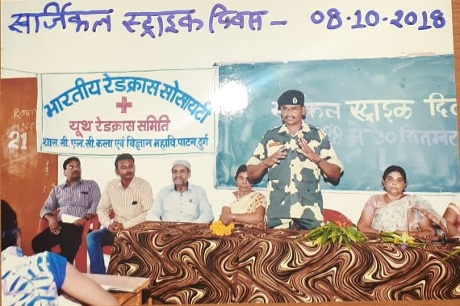

Slide 28
d. K. bhardwaj
Assistant Professor, Department Of Zoology

