Slide 1
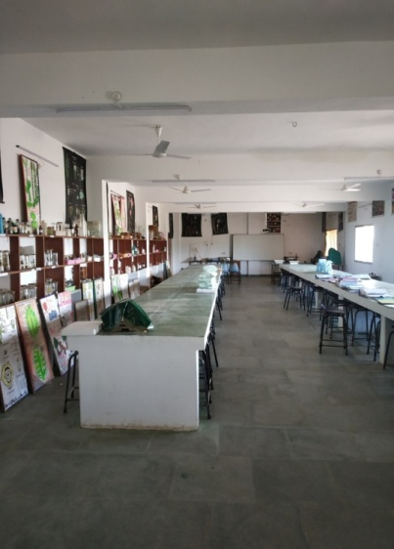
WELCOME TO
DEPARTMENT OF
BOTANY
Since 20.05.2010
AND
CAREER COUNSELLING UNIT

Slide 2
Vision
To establish and to be recognized as a department of high standard in teaching and learnining of recent plant science based approaches and to enhance chances of employability of students.

Slide 3
MISSION
In order to prepare mechanism for fulfillment of vision and goals, Group discussion and debate based approach should be incorporated along with regular teaching.
To make students updated in the field of employability, soft skill development workshops are to be introduced.

Slide 4
FUTURE PLAN
To create links in college website for open discussions, information sharing and feedback based contribution.
To increase facilities for greenery enhancement in campus and to introduce new plant varieties in Botanical Garden along with listing, auditing, QR coding and geotagging of the available plants.
To create environment for competitive exams like NET,SET and GATE.

Slide 5
RUNNING PROGRAMS
Name of the Program | Main subject | Category | Duration | Intake per year | Start from | Type of course
M.Sc. Botany | Botany | PG (Science) | 4 Semesters | 20 | 2010-11 | Self-financing
B.Sc. | Botany, along with chemistry and Zoology | UG (Science) | 3 years | 60 | 1990-91 | Government

Slide 6
Details of the faculty
Name of the Post | Sanctioned | Post Filled | Post Vacant
Professor | 00 | 00 | 00
Assistant Professor | 01 | 01 | 00
Two posts of Assistant Professors (JBS) are sanctioned by the JBS to run the self-financing course successfully.

Slide 7
Extension Activities of the Botany Department
A Botanical Garden is being developed.
An Oxyzone garden is being maintained.
A Medicinal plants Garden is being developed.
Mushroom spawn production is introduced to PG students.

Slide 8
Extension Activities

Slide 9
STUDENTS IN MERIT LIST
S.N. | NAME OF STUDENT | FATHER’S NAME | YEAR | MERIT POSITION
1 | KU. SURABHI | SRI SALIK RAM | 2015-16 | TENTH
2 | POSHAN KUMAR | SRI RAMA NISHAD | 2016-17 | FIFTH
3 | KU. KHUSHBU | SRI RAJENDRA KUMAR | 2016-17 | NINTH

Slide 10
Botany Department Faculties
S No | Faculty Name | Qualification | Department | Designation | Mobile No
1 | Mr. PRAVEEN KUMAR JAIN | M.Sc. CSIR NET-2001,2002 ,M.TECH. | Botany | ASSTT. PROF. (BOTANY) | 8827494325
2 | NEHA CHANDRAKAR | M.Sc. | Botany | JBS Asstt. Prof. | 6263864257
3 | DEEKCHHA SONWANI | M.Sc. | Botany | JBS Asstt. Prof. | 7089161411

Slide 11
Students enrollment data
+2015-16 | 2016-17 | 2017-18 | 2018-19 | 2019-20 | 2020-21
B.Sc.-I- 60 B.Sc.-II- 34 B.Sc.-III-23 M.Sc.-I- 20 M.Sc.-III-18 | B.Sc.-I- 60 B.Sc.-II-42 B.Sc.-III-38 M.Sc.-I- 20 M.Sc.-III-19 | B.Sc.-I-60 B.Sc.-II-60 B.Sc.-III-49 M.Sc.-I-20 M.Sc.-III-19 | B.Sc.-I-60 B.Sc.-II-58 B.Sc.-III-60 M.Sc.-I-20 M.Sc.-III-17 | B.Sc.-I-60 B.Sc.-II-46 B.Sc.-III-60 M.Sc.-I-20 M.Sc.-III-20 | B.Sc.-I-60 B.Sc.-II-60 B.Sc.-III-53 M.Sc.-I-20 M.Sc.-III-19

Slide 12
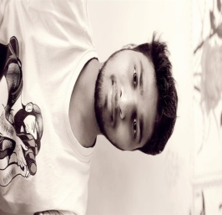
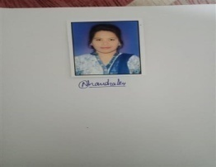
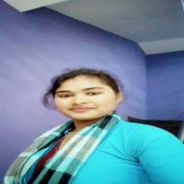
Alumni
Names /Details | Posts
Jhanak Lal Sinha/ Mr. Teeka Ram Sinha | CSIR-CIMFR (Central Institute of Mining and Fuel Research Centre) Nagpur, MH 7999115494
Neha Chandraker/ Mr. Tikam Lalchandraker | Govt. Chandulal Chandrakar Arts and Sciences College Patan, Durg .JBS Assistant Professor, 6263864257
Daminee/ Mr. Ramsahayak | Gyandip Higher Secondary School Gunderdehi, Private School Teacher, 6264162883

Slide 13
STUDENTS RESULT
2015-16 | 2016-17 | 2017-18 | 2018-19 | 2019-20 | 2020-21
B.Sc.-III-23 M.Sc.4-18 | B.Sc.-III-38 M.Sc.-4-19 | B.Sc.-III-44 M.Sc.-4-19 | B.Sc.-III-54 M.Sc.-4-17 | B.Sc.-III-60 M.Sc.-4-20 | B.Sc.-III-60 M.Sc.-4-

Slide 14
Educational Tour on 27/04/2019

Slide 15
STUDENTS’ VISIT TO THE COTTON CLOTH UNIT

Slide 16
An Educational Model Experiment

Slide 17
Cultural activity by botanical society

Slide 18
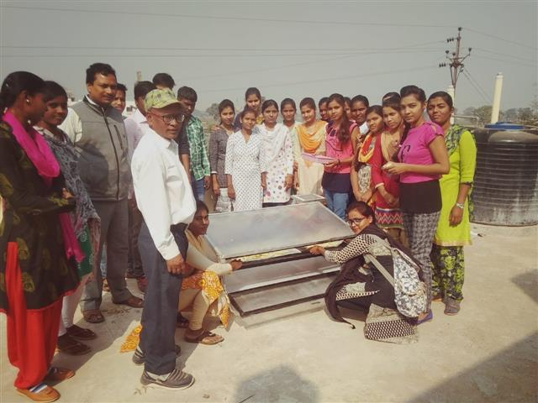
Introduction of new instruments
Solar dryer for vegetables and fruits

Slide 19
Plantation drive

Slide 20
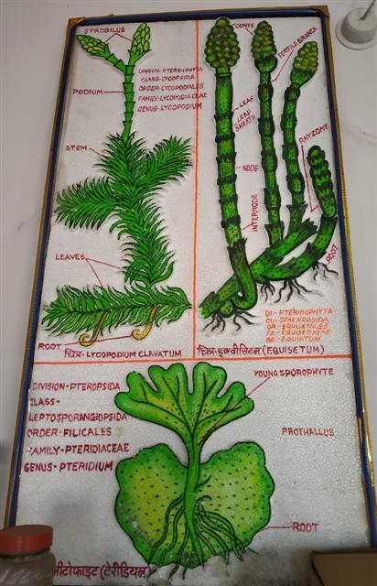
MODELS PREPARED BY STUDENTS-1

Slide 21
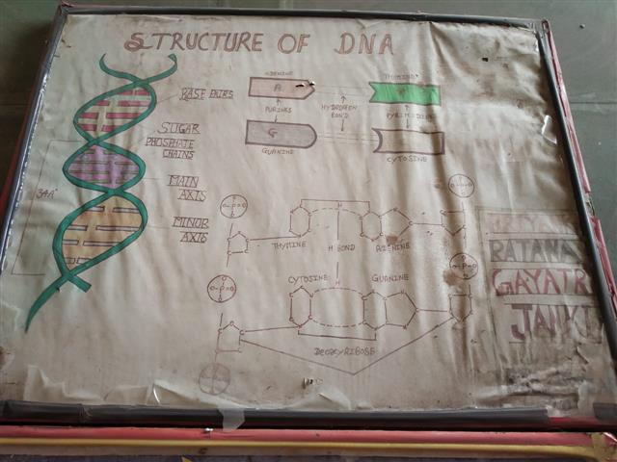
MODELS PREPARED BY STUDENTS- 2

Slide 22
Mushroom Spawn Preparation

Slide 23
List of Books: Departmental PG Library

Slide 24
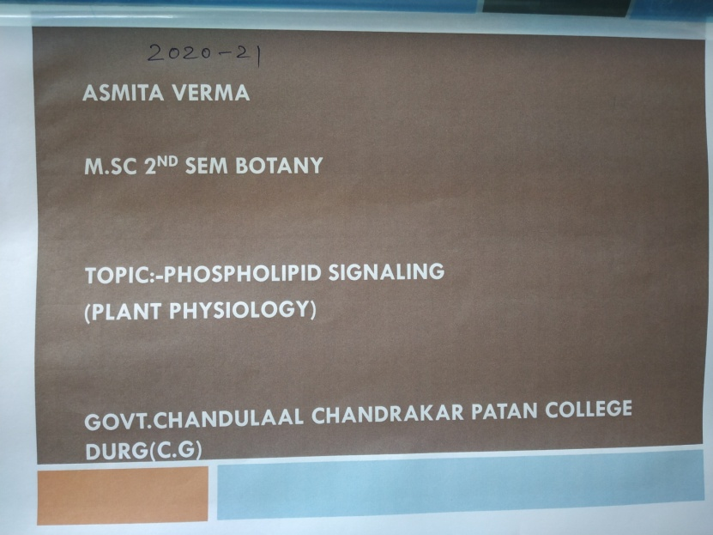
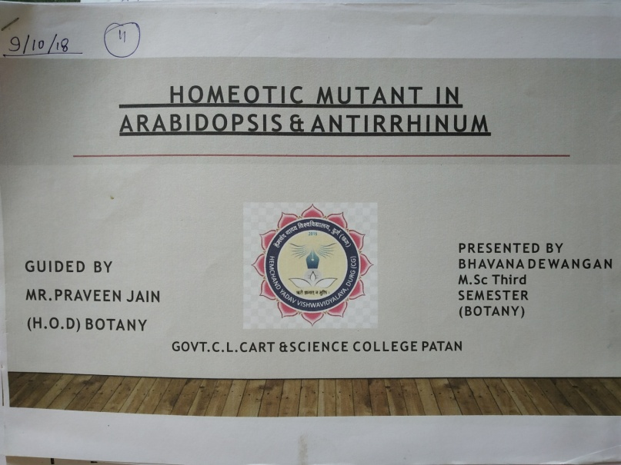
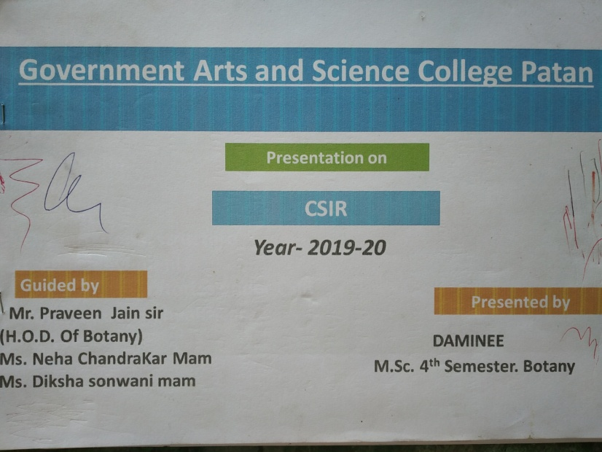
PRESENTATIONS AND PROJECTS AND REPORTS BY STUDENTS

Slide 25
PRESENT TIMETABLE

Slide 26
UG- TIMETABLE

Slide 27
A CERTIFICATE FROM STUDENT PLACED AFTER PG IN BOTANY

Slide 28
ALUMNI OF THE DEPARTMENT

Slide 29
DATA: ALUMNI OF THE DEPARTMENT

Slide 30
ALUMNI OF THE DEPARTMENT

Slide 31
PRESENTATION OF CAREER COUSELLING UNIT

Slide 32
Vision
To create and facilitate the employability opportunities for students as well as non permanent staff.
FUTURE PLAN
To establish MOU with HR company/companies or organizations such as coaching Centers and schools etc.

Slide 33
MISSION
To use ICT as maximum inception method for organizing the Guest lecturers from various professionals.
To assist students in their career awareness and provides information that helps the students to give a direction to their aspirations and interests.
The College believes in timely counseling that enhances the students to compete with the forthcoming challenges in Life.
Interactive sessions by the eminent persons are conducted.

Slide 34
PROGRAMS ORGANIZED-1
S.NO. | TITLE OF THE PROGRAMME ORGANIZED | NAME OF GUEST FACULTY/ WORKING BODY | DATE OF EXECUTION AND NUMBER OF STUDENTS BENEFITTED
1 | PREPARATION OF COMPETITIVE EXAMS | ABHISHEK ROY (ABS GROUP) PRAKASH PALIWAL (RAMA COACHING) | 27.11.2018 -82 STUDENTS
2 | WORKSHOP ON FSSAI | SOUMALYA BANERJEE NITIN SINGHANIA (HEALTH DEPTT. CENTRAL GOVT.) | 04.12.2018 -73 STUDENTS
3 | SBI LIFE-CAREERS AND JOB PLACEMENT | ABHISHEK SINHA VIVEK JAIN | 13.12.2018 -67 STUDENTS 15 SELECTED FOR INTERVIEW
4 | PERSONALITY DEVELOPMENT | DR.SANTOSH ADIL (MOTIVATOR AND PHYSICIAN) | 23.01.2019 -100 STUDENTS
5 | TEST OF TALENT COMPETITION AND TRAINING | PARENDRA SAHU SADHYA ACADEMY RAIPUR | 27.09.2019 -139 STUDENTS 300 BOOKS OF GK DISTRIBUTED , FREE OF COST

Slide 35
PROGRAMMES ORGANIZED-2
6 | FOOD AND BIOTECH INDUSTRIES EDP-3 DAY PROGRAM | CITCON (DIRECTOR-MR. P NIMONKAR) | 25.02.2020-27.02.2020 TOUR TO SRT-AGROTECH FUNDA-29.02.2020 75 STUDENTS GOT CERTIFICATE
7 | PREPARATION TO UPSC, PSC,SSC, ETC. | DR. VINAY SINGH TEJAS ACADEMY CIVIC CENTRE BHILAI | 2.3.2016 -82 STUDENTS
8 | HOME HERBAL GARDENING | HORTICULTURE DEPTT. MR.B.NAYAK | 500 MEDICINAL PLANTS DISTRIBUTED CULTIVATION BOOKS DISTRIBUTED -69 STUDENTS
9 | ACCOUNTING SOLUTIONS– SOFTWARES | PIYUSH AGARWAL CA,CMA,CS | 14.9.2016 -22 STUDENTS
10 | ENHANCING EMPLOYABILITY THROUGH COMMUNICATION SKILL DEVELOPMENT SDC | DR. G.A. GHANSHYAM | 21.10.2016 -134 STUDENTS
11 | NETWORKING AND JOB OPPORTUNITIES | S. KASHYAP AND M. SINGH | 16.11.16 -63 STUDENTS

Slide 36
PROGRAMS ORGANIZED-3
12 | HOME DÉCOR AND INTERIOR DESIGNING | MR. S.D.MISHRA | 28.11.16 -133 STUDENTS
13 | JOB OPPORTUNITIES IN E COMMERCE | A. UPADHYAY (KALINGA UNIVERSITY RAIPUR) | 15.12.2016 - 40 STUDENTS
14 | WODEN ART –BASTAR 3 DAY WORKSHOP | DR. P.S. CHURENDRA (TRAINER ) | 13.02.2017-15.02.2017 - 73 STUDENTS
15 | RAESONING AND LOGIC (VERBAL AND NON VERBAL) | MOHIT KUMAR | 1.9.2017 - 36 STUDENTS
16 | PREPARATION OF IAS | TEJAS ACADEMY CIVIC CENTRE PRINCE PANDEY AVINASH VERMA | 6.9.2017 - 72 STUDENTS
17 | SALES MANSHIP IN AUTOMOBILE SECTOR | TATA MOTORS BHILAI BRACH ABHISHEK SAMUEL | 18.09.2018 - 71 STUDENTS

Slide 37
OBJECTIVES
To give guidance to students on career related matters and assist them in exploring new opportunities.
To organize various types and levels of training programs like personality development, Competition exam. Preparation, experience sharing by eminent personalities, communication skills and conduct model tests for various types of aptitude tests.
To display various job advertisements coming in employment news, opportunities and career columns in leading news papers.
Following activities are done in the college -1. Aptitude Test 2. GK Test 3. English Grammar and Verbal Ability Awareness 4. Training for Group Works and Team Effectiveness 5. Communication Skills 6. Lecture on Personality Developing 7. Awareness about IAS, PSC, NET, SET, RAILWAY and other type of competition exam.

Slide 38
A SAMPLE OF WOODEN ART PREPARED BY STUDENTS UNDER THE AEGIS OF CAREER AND COUNSELLING UNIT OF COLLEGE

Slide 39
THANK YOU

